Slide 1

CYBER BULLYING DETECTION SYSTEM

Slide 2

TEAM MEMBERS
20BAI10092 OISHI BASAK
20BAI10264 SAHIL ARORA
20BAI10324 VATSAL AGARWAL
PROJECT GUIDE
100260 DR. LAKSHMI D ( ASSOCIATE PROFESSOR, SCSE)

Slide 3
INTRODUCTION
Cyberbullying is bullying with the use of digital technologies. It can take place on social media, messaging platforms, gaming platforms and mobile phones. It is repeated behavior , aimed at scaring, angering or shaming those who are targeted.
Face-to-face bullying and cyberbullying can often happen alongside each other. But cyberbullying leaves a digital footprint – a record that can prove useful and provide evidence to help stop the abuse.
The non-consensual distribution of intimate images involves the sharing of intimate images, often of a former partner, with third parties (either via the Internet or otherwise) without the consent of the person depicted in the image. Often the motivation is to take revenge against their former partner. Its effect is a violation of the former partner's privacy in relation to images, the distribution of which is likely to be embarrassing, humiliating, harassing, or degrading to that person.

Slide 4
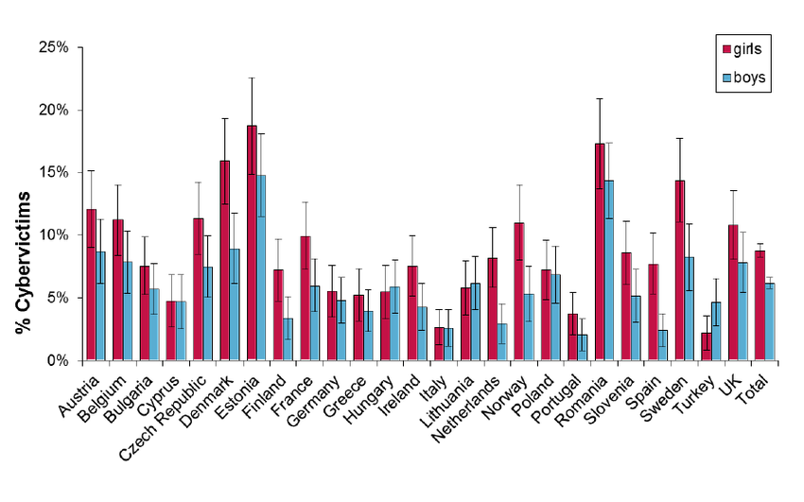
INTRODUCTION
India ranked 3rd for cyber-bullying crimes, and this is not even shocking anymore as the number of users are rising day by day and most of them are fake accounts
As per the nationwide survey conducted by Symantec, around 8 people out of 10 people are a victim of different-different types of cyber-bullying. Among these, around 63% of people were a victim of online abuses or harassment and 59% of people were a victim of fake gossips and rumors destroying their image.

Slide 5
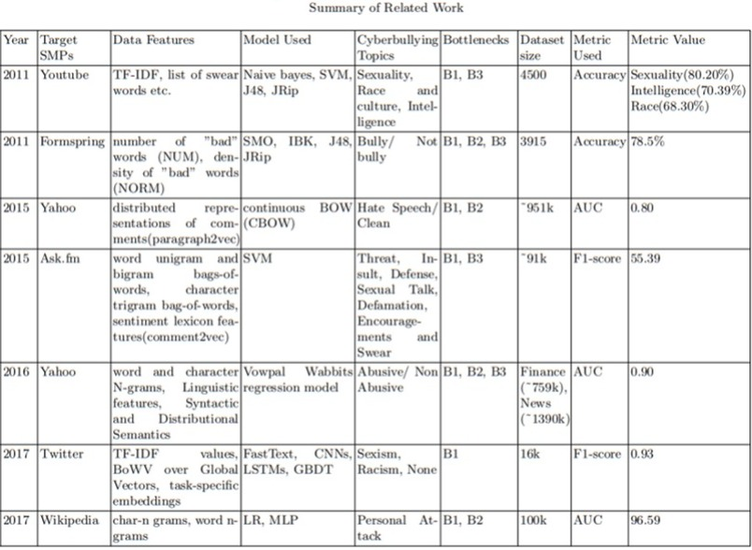
EXISTING WORKS

Slide 6
LIMITATIONS
The detection of Cyber-Bullying is so difficult in today’s era. Bullying is most apparent in younger age groups through direct verbal outings , and more subtle in older groups, mainly manifested in more complex social dynamics such as exclusion, sabotage, and gossip .
To understand the task of cyberbullying detection as a specific domain of text classification, one should consider the full scope of the register that defines it which lags in every Cyber - Bullying Detection application / Software
While some roles clearly show from frequent interaction with either a positive or negative sentiment , others might not be observable through any form of conversation , prove too subtle, or not distinguishable from other roles.

Slide 7
PROPOSED WORK AND METHODOLOGY
Cyberbullying Detection implements our coded, machine learning algorithms, in finding a negative comment from the messages it receives by a user.
The algorithm first gives the message a value and then based on our pre trained data, it decides if the comment is harsh enough to be transformed or not. If so, the message is run through a series of models in order to change negative components of the sentence into positive components.
The transformed sentence is then checked by our initial algorithms. The users communicate through a developed web front face and they are connected to a central server.

Slide 8
PROPOSED WORK AND METHODOLOGY
Data Input
Tweets
PRE – PROCESSING
Lower Case
Reduce repeated letters
Standardize URL’s and @user mentions
Tokenization
Stemming
Stop words removal
Feature Extraction
Text Representation
POS tagging
Feature Generation
Pointwise Mutual Information (PMI)
Feature Selection
Embedding Feature Vectors
Sentiment Features
Lexicon Features
PMI – Semantic Orientation
ML Algorithms
Naïve Bayes
KNN
J48
Random Forest
SVM
Performance Evaluation
Kappa Statistics
Accuracy
F-Measure
AUC
Precision & Recall

Slide 9

NOVELTY OF THE PROJECT
Our proposed framework provides a feasible solution to detect cyberbullying behavior and its severity in online social networks.
We have proposed a cyberbullying detection framework to generate features from Twitter content by leveraging a pointwise mutual information technique.
Based on these features, we developed a supervised machine learning solution for cyberbullying detection and multi-class categorization of its severity in Twitter.

Slide 10
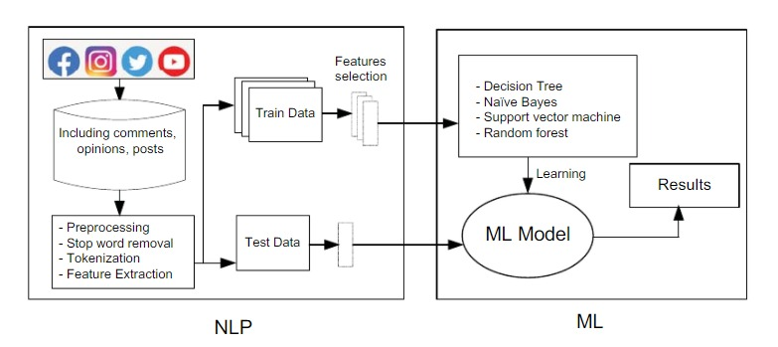
REAL TIME USAGE

Slide 11
HARDWARE AND SOFTWARE REQUIREMENTS
HARDWARE REQUIREMENTS
PC with at least following specifications :-
Memory: 16 GB DDR4-3200
GPU : Nvidia GTX 1080 (4 GB VRAM)
Processor: Intel Core i5-9300H
Any OS

Slide 12
HARDWARE AND SOFTWARE REQUIREMENTS
SOFTWARE REQUIREMENTS –
Virtual Studio Code
Jupyter Labs (Conda )
PyCharm
Microsoft Excel
Any compatible browser

Slide 13
HARDWARE AND SOFTWARE REQUIREMENTS
Tools Required –
Anaconda (version.4.7.12)
Python 3.6 (or any version of Python 3)
Scikit-learn (version 1.1.0)
Pandas (version 0.24.1)
Numpy (version 1.15.4)
TensorFlow (version 1.15)
Seaborn (version 0.11.2)
Matplotlib (version 3.4.3)

Slide 14
SYSTEM ARCHITECTURE DIAGRAM
Web Scraping
Compiling the
Dataset
Implementing various M.L techniques **
Detecting whether the particular image or phrase is offensive or not
Data
Pre-processing
IF NOT
Cleaning
Detecting whether the website contains offensive words or not
Transforming
IF YES
Generating Report
Feature Selection
The offensive post / comment will be deleted.
Deployment on browser
Train Data
Test Data

Slide 15
REFERENCE PAPERS
Neural Models for Offensive Language Detection
https://arxiv.org/pdf/2106.14609.pdf
Automated Hate Speech and Offensive Language Detection
https://www.researchgate.net/publication/314942659_Automated_Hate_Speech_Detection_and_the_Problem_of_Offensive_Language
A Multichannel Deep Learning Framework for Cyberbullying Detection on Social Media
https://www.researchgate.net/publication/355845224_A_Multichannel_Deep_Learning_Framework_for_Cyberbullying_Detection_on_Social_Media
Collaborative Detection of Cyberbullying Behavior in Twitter Data Amrita Mangaonkar, Allenoush Hayrapetian, Rajeev Raje
(PDF) Collaborative detection of cyberbullying behavior in Twitter data (researchgate.net)

Slide 16
MODULE DESCRIPTION
1. Web Scraping -
It extracts content and data from a website. Unlike screen scraping, which only copies pixels displayed onscreen, web scraping extracts underlying HTML codes, and with it, data stored in a database. The scraper can then replicate the entire website content elsewhere.
2. Data Collection –
Data collection is the process of gathering and measuring information on variables of interest, in
an established systematic fashion that enables one to answer stated research questions, test
hypotheses, and evaluate outcomes.
3. Data Wrangling –
Data wrangling is the process of cleaning and unifying messy and complex data sets for easy
access and analysis. It is also known as data cleaning. It encompasses all the work done on your
data prior to the actual Analysis.

Slide 17
MODULE DESCRIPTION
4. Data Normalization -
Data normalization is a process in which data attributes within a data model are organized
to increase the cohesion of entity types. The goal of data normalization is to reduce and even
eliminate data redundancy.
5. Feature Selection -
Feature Selection is the process where you automatically or manually select those features which
contribute most to your prediction variable or output in which you are interested in.
6. Model Building -
Model building is the process of developing a probabilistic model that best describes the relationship
between the dependent and independent variables.
7. Deployment-
The concept of deployment in data science refers to the application of a model for prediction
using new data.

Slide 18
MODULE WORKFLOW
WEB SCRAPING
Identify the target website and inspect the data source
Collect URLs of the pages where you want to extract data from (in our case, we will be using Twitter API or Twint module from Python library)
Make a request to these URLs to get the HTML of the page
Use locators to find the data in the HTML
Scrape HTML Content From a Page
Parse HTML Code with Beautiful Soup
Save the data in a JSON or CSV file or some other structured format that would help to create dataset.

Slide 19
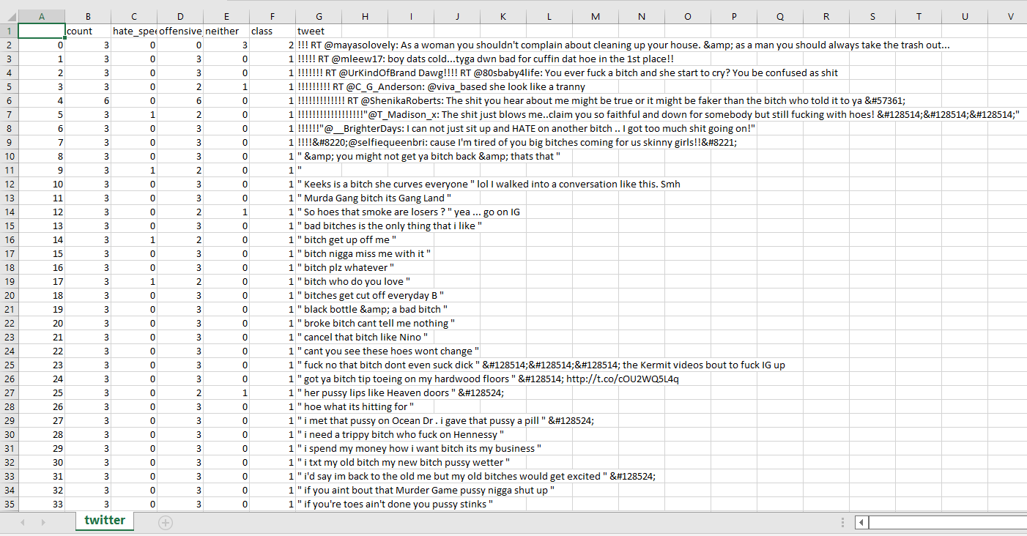
MODULE WORKFLOW
DATA COLLECTION
Accurate data collection is essential to
ensure the integrity of the research,
regardless of the field of study or data
preference.
The goal for all data collection is to capture
quality evidence that allows analysis to lead
to the formulation of convincing and
credible answers to the questions that have
been posed.
In our project we are using CSV file to make our dataset.

Slide 20
MODULE WORKFLOW
DATA NORMALIZATION
Normalization is a scaling technique in which values are shifted and rescaled so that they end up ranging between 0 and 1.
Normalization gives equal weights/importance to each variable so that no single variable steers model performance in one direction just because they are bigger numbers.
It is useful in algorithms that do not assume any distribution of the data like K-Nearest Neighbors and Neural Networks.
Min-max normalization, rescaling, mean normalization, etc. are some effective techniques for data normalization.
On identifying the critical features, we have to use feature scaling.

Slide 21
MODULE WORKFLOW
FEATURE SELECTION
Also known as variable selection, attribute selection or variable subset selection, is the process of selecting a subset of relevant features (variables, predictors) for use in model construction.
It is the process of isolating the most consistent, non-redundant, and relevant features to use in model construction. The main goal of feature selection is to improve the performance of a predictive model and reduce the computational cost of modelling.
It refers to techniques that assign a score to input features based on how useful they are at predicting a target variable. The role of feature importance in a predictive modelling problem. Some techniques include Correlation Coefficient, Chi-Square Method, Recursive Feature Elimination, Random Forest Importance, etc.

Slide 22
MODULE WORKFLOW
MODEL BUILDING
The model building process involves setting up ways of collecting data, understanding and paying attention to what is important in the data to answer the questions you are asking, finding a statistical, mathematical or a simulation model to gain understanding and make predictions.
It involves asking questions, gathering and manipulating data, building models, and ultimately testing and evaluating them.
DATA VISUALIZATION
The process of translating large data sets and metrics into charts, graphs and other visuals. We will be demonstrating the confusion matrix, the ROC curve and the accuracy metrics of the different ML algorithms used.

Slide 23
MODULE WORKFLOW
As the size of Twitter data is increasing, so are undesirable behaviors of its users. One of such undesirable behavior is cyberbullying, which may even lead to catastrophic consequences. Hence, it is critical to efficiently detect cyberbullying behavior by analyzing tweets, if possible in real time. Prevalent approaches to identify cyberbullying are mainly stand-alone and thus, are time-consuming. This research improves detection task using the principles of collaborative computing. Different collaborative paradigms are suggested and discussed in this paper.
In the process of cleaning data, we keep information of some objects and words, like counts of URLs, Mentions, Retweets, and the number of all words, even though these objects and words are removed in the process. Steps of processing tweet data:
• Remove URLs and emoji using regular expressions
• Tokenize text based on space characters and convert words into lowercase
• Remove words beginning with Mention (@)
• Convert contractions to formal writing based on a dictionary we build, and then remove punctuations
• Remove words with length less than 2 and words that are not alphabetic
• Remove stop words. For the stop word list, add some common words in tweets, like ’rt’ and ’ff’, and remove negation words which may be important in bigram features.
• Stem and lemmatize words to convert inflectional forms and derivational forms of words to base forms.

Slide 24
IMPLEMENTATION AND CODING
This model scraps Twitter so as to scan for tweets.
After web scraping (with the help of Twint and Tweepy modules in Python and Beautiful Soap and Selenium and Twitter API) we make our .csv file.
After the .csv file is prepared, we need to preprocess the data and clean the data and distinguish and convert the continuous data into categorical data.
Then we will divide our dataset in testing and training set for training and testing of our model.
Then we need to apply Machine Learning Models (such as Support Vector Machines, Logistic Regression, Vectorization, Decision Tree Classifiers, Neural Networks) to detect the presence of hate tweets.
After the detection, we need to analyze the result.
We will make a Google extension so that it works on every website in Google. Our extension directly connects the Twitter website to our Machine Learning model and gives the output.
If a hate tweet is found, our model flashes a warning to the user.
If the Twitter website has no such hate tweets, it launches smoothly.

Slide 25
SNAPSHOTS OF OUR PROJECT
Web Scraping is done by using Beautiful Soup and Selenium and Twint and Tweepy modules in Python and using the required python modules like Pandas and NumPy for making data frames from the prepared data set achieved from web scraping.

Slide 26
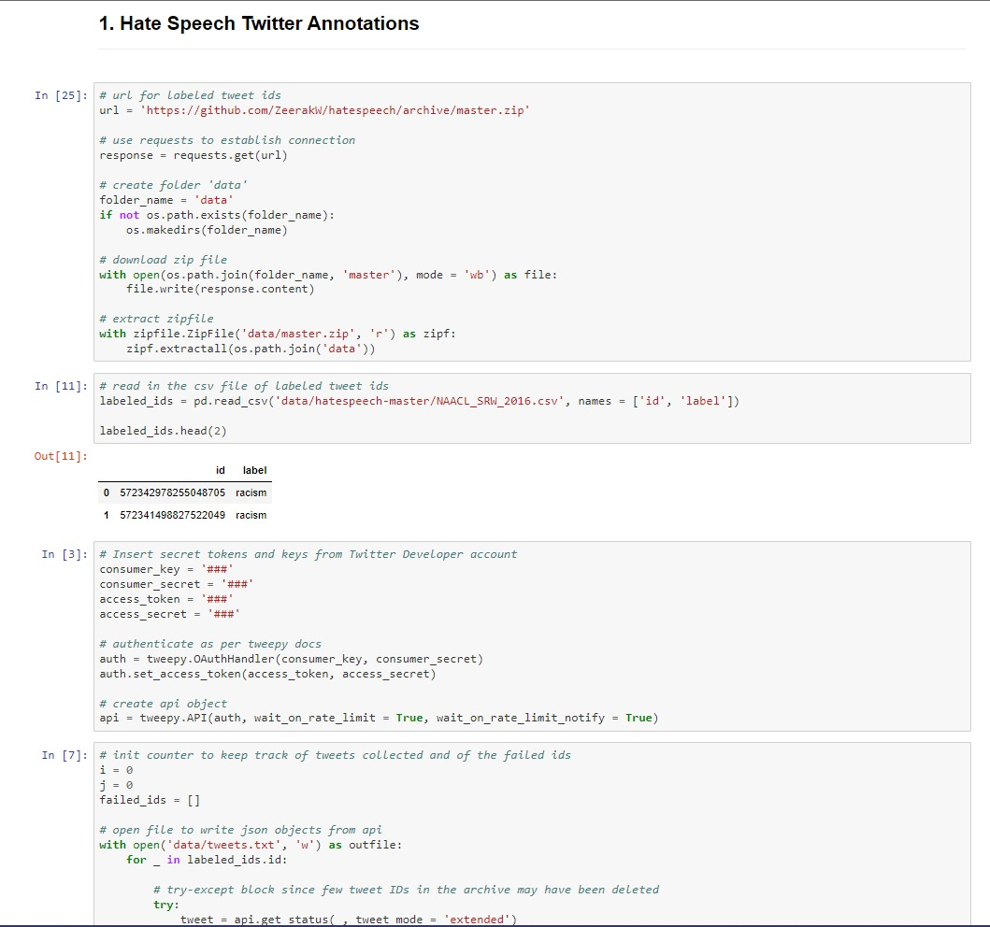
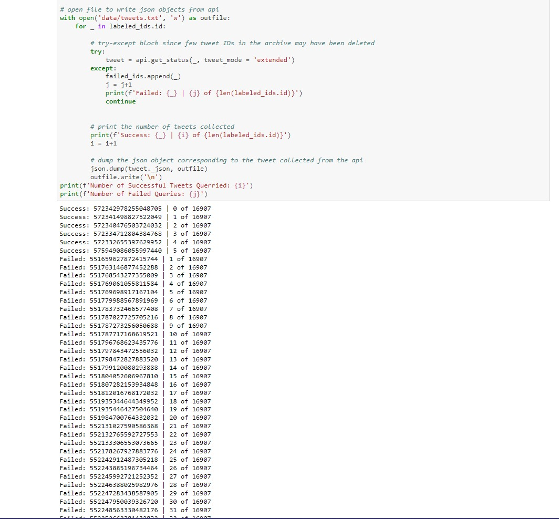
CODES

Slide 27
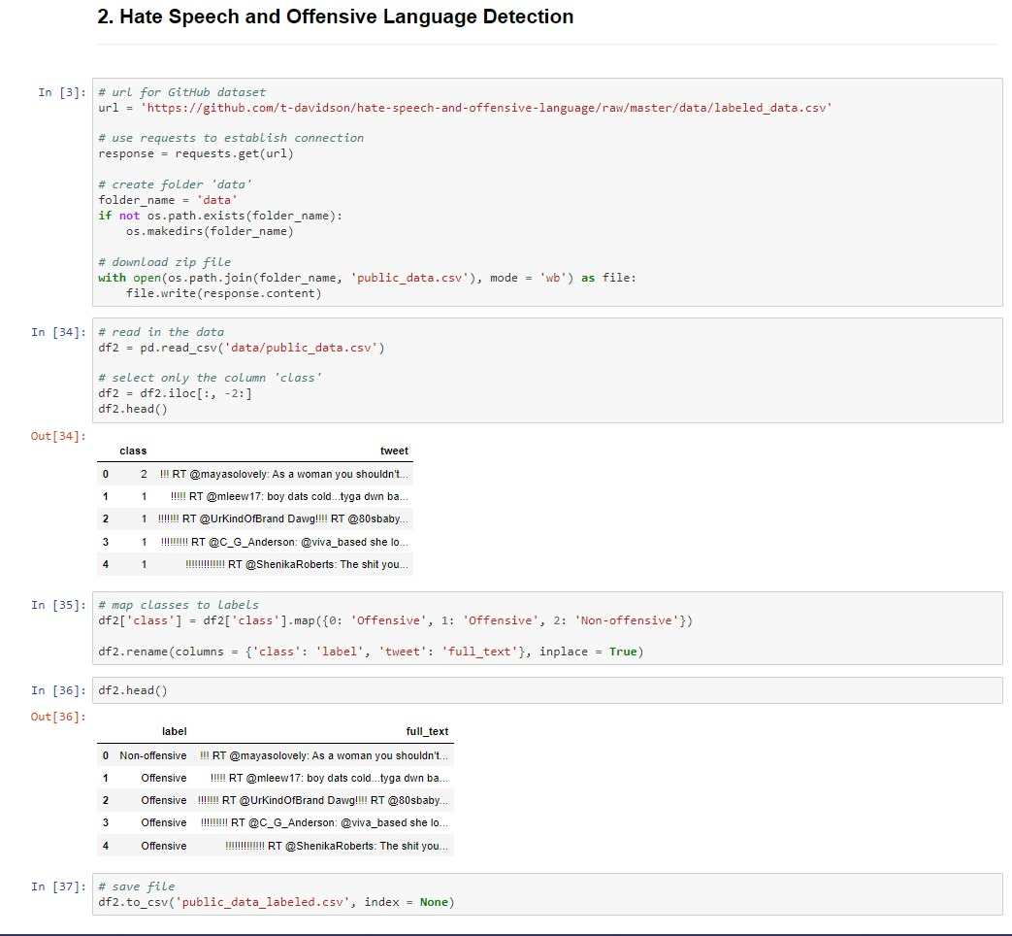
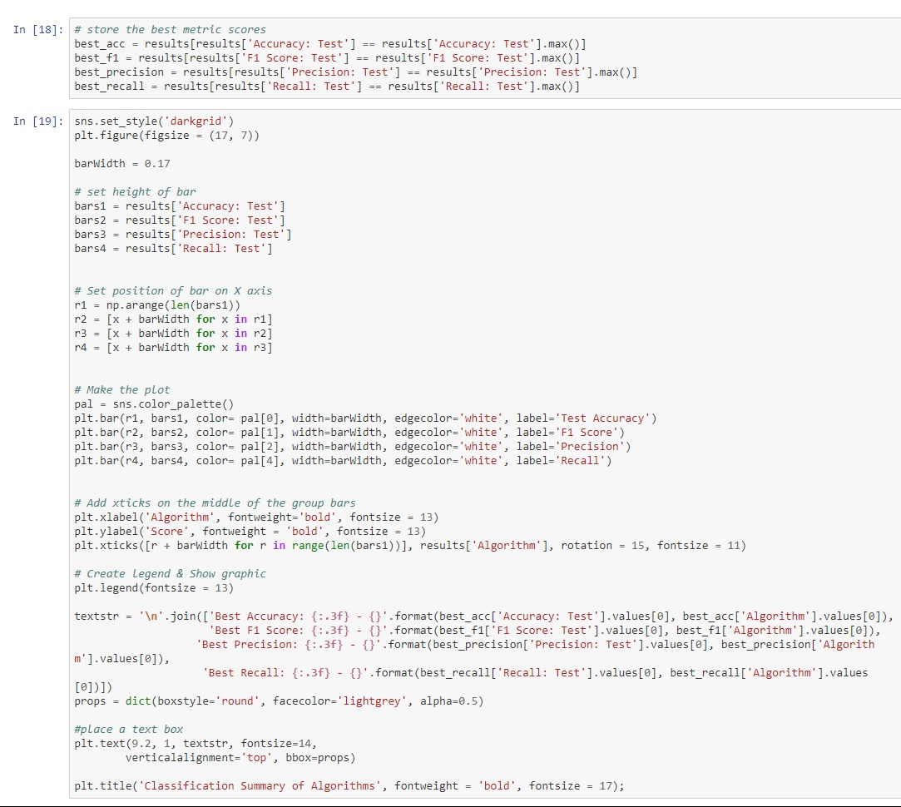
CODES

Slide 28
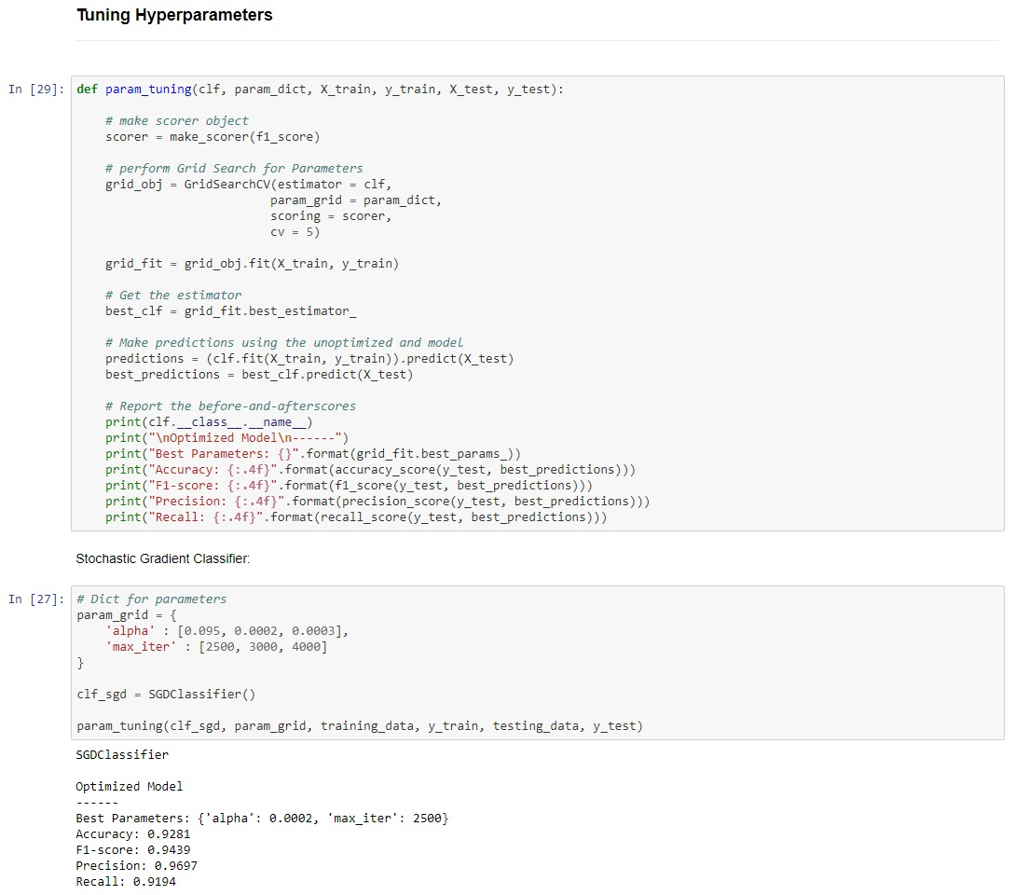
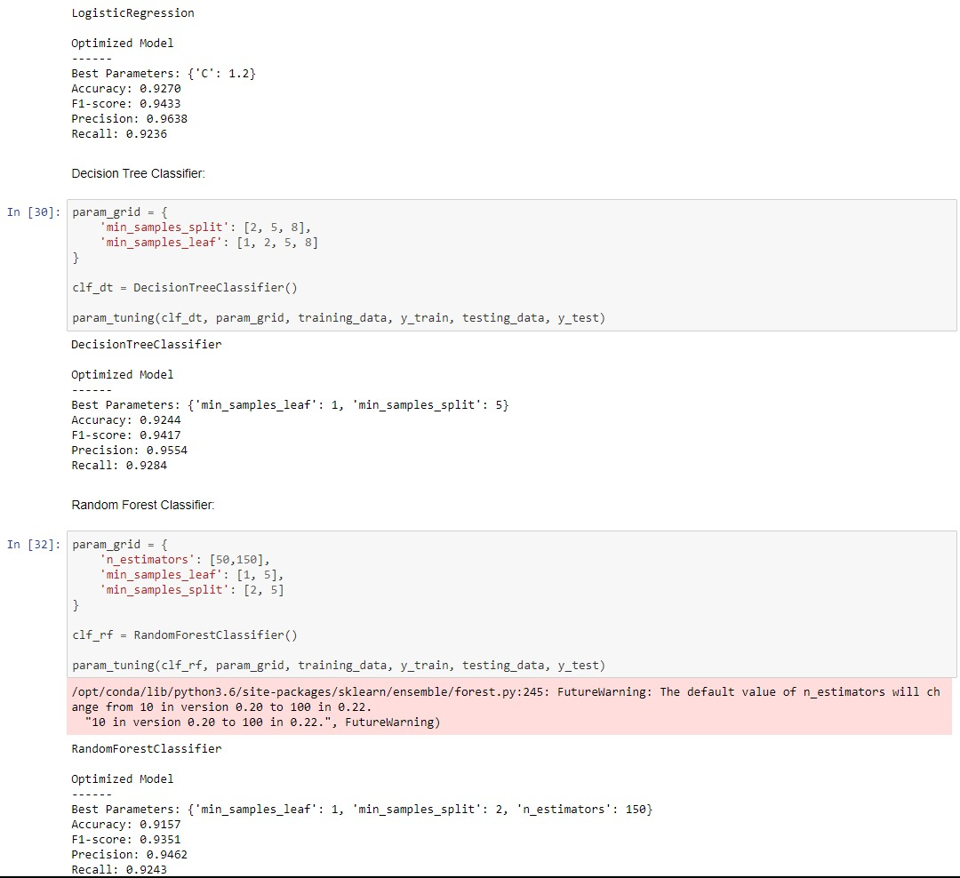
CODES

Slide 29
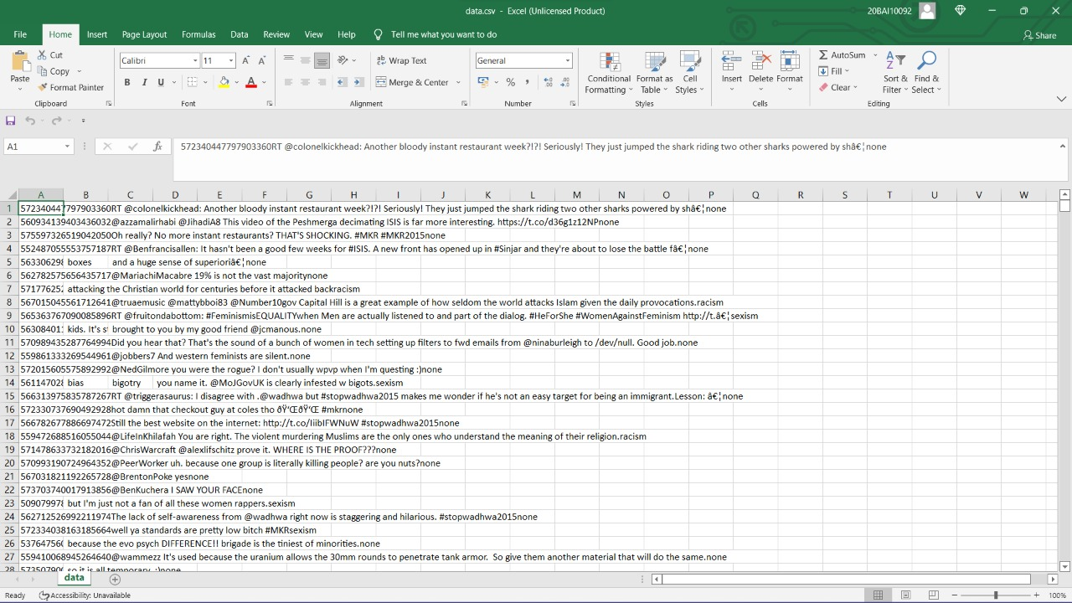
IMPORTED DATASET

Slide 30
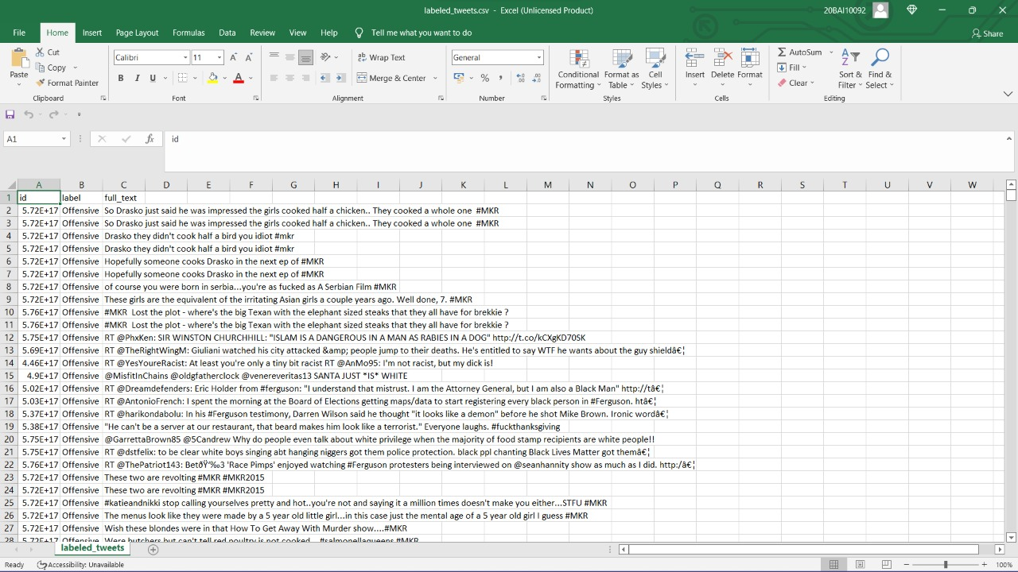
PREPARED DATASET

Slide 31
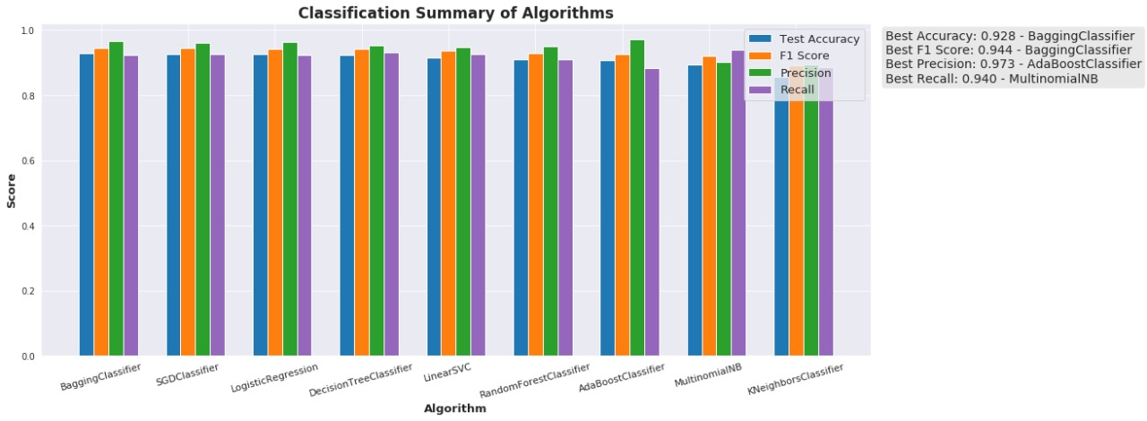
OUTPUT

Slide 32
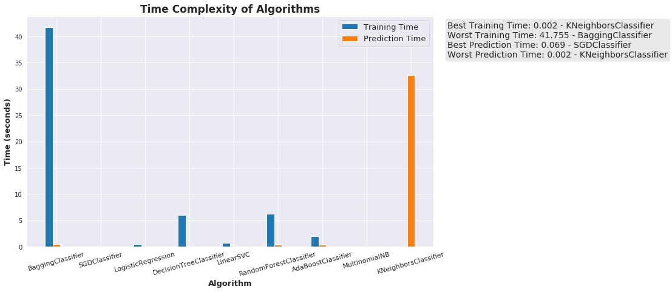
OUTPUT

Slide 33
CONCLUSION
Our model presents a cyberbullying detection technique using a combination of four machine learning architectures (i.e., SGD, Logistic Regression, Linear SVC, Decision Tree and Random Forest Classifier models). The proposed method is evaluated using real-time dataset achieved by web scraping of the Twitter API to have enough samples to train our model. The experimental results show the significance of this method in classifying short messages (e.g., tweets). The proposed method achieved good results compared to the state-of-the-art methods on the dataset, achieving an accuracy of approximately 88% when the dataset was split into 75% training and 25% testing.
In this study, we detected cyberbullying using machine learning algorithms. Then results were presented in a tabular format. The results depicted that SGD and Ensemble performed better than remaining classifiers with 95% average accuracy. The second one is Logistic Regression with 92% accuracy, then Random Forest with average 91%, Decision Tree classifier 92.4% accuracy while Linear SVC performed classification with 92.57% accuracy. However, in this study, only textual features were considered. For future, network and contextual features can be considered.

Slide 34
Thank You

